Slide 1

2025 Akoma
Scholarship Presentation
30 Years of
Choral. Oral. Cultural.
Spiritual Praise.
O praise the Lord, all ye nations:
praise Him, all ye people. For His merciful kindness is great toward us: and the truth of the Lord endureth forever. Praise ye the Lord.
Psalms 117

Slide 2

Donna M. Jones
Outgoing
Scholarship Chairwoman
Dr. Arielle Sheftall
Incoming
Scholarship Chairwoman

Slide 3
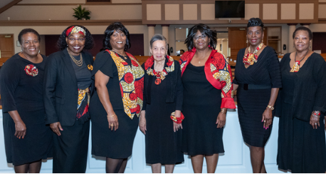
2025 AKOMA Scholarship Commission
Wynndy Turner, Esther Pinkston, Gloria McCullough, Rose Stokes,
Donna M. Jones – Chairwoman, Sharon Chandler, Dr. Gaya Shakes
Not Pictured Dr. Arielle Sheftall and Marcelle Davis

Slide 4
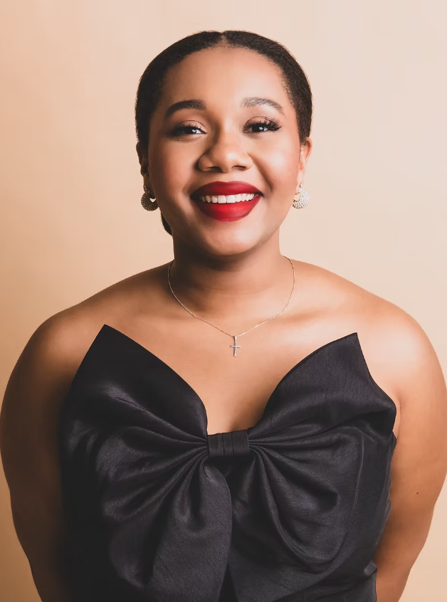

2018 Akoma
Nona Patterson Chambers
Scholar

Slide 5
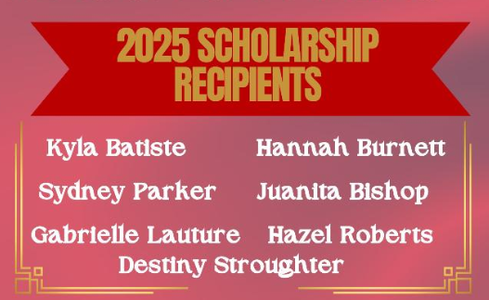

Slide 6
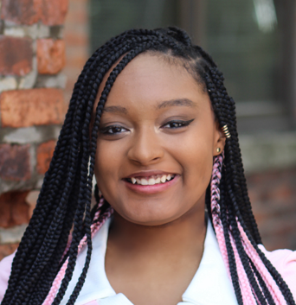
2025 AKOMA Nona Patterson Chambers Scholar
Kyla Batiste
PARENTS: Marcus and Monifa Batiste
MAJOR: Film
MINOR: Theater and Dance
HIGH SCHOOL: Penfield High School
UNIVERSITY: Ithaca College (NY)
GOAL: Filmmaker

Slide 7
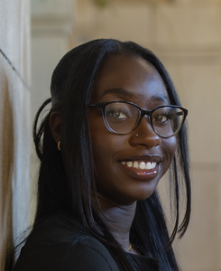
2025 AKOMA Nona Patterson Chambers Scholar
Juanita Bishop
PARENTS: Ap Bishop and Princess Sobah
MAJOR: Nursing
HIGH SCHOOL: Churchville-Chili Senior High
UNIVERSITY: St. John Fisher University (NY)
GOAL: Certified Registered Nurse
Anesthetist

Slide 8
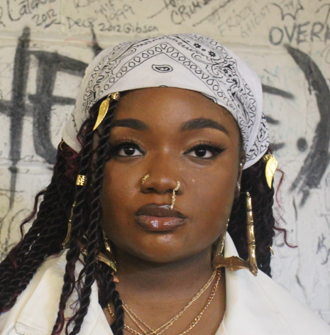
2025 AKOMA Nona Patterson Chambers Scholar
Hannah Burnett
MOTHER: Heashla Burnett
MAJOR: Biology - Premedical
HIGH SCHOOL: Charles Finney School
UNIVERSITY: Kent State University (NY)
GOAL: Physician or Surgeon

Slide 9
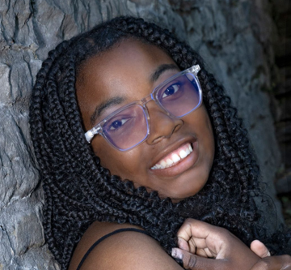
2025 AKOMA Nona Patterson Chambers Scholar
Gabrielle Lauture
PARENTS: Emmanual Lauture
& Tiona McCauley
MAJOR: Psychology
HIGH SCHOOL: Webster Thomas High School
UNIVERSITY: Rochester Institute of
Technology (NY)
GOAL: Neuropsychologist

Slide 10
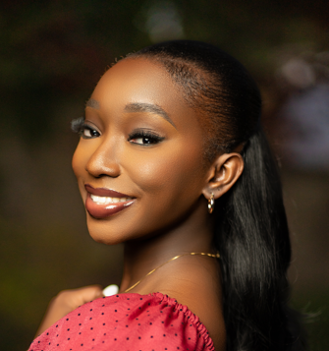
2025 AKOMA Nona Patterson Chambers Scholar
Sydney Parker
MOTHER: Alexis D. Burgess
MAJOR: Nursing
HIGH SCHOOL: Churchville-Chili Senior High
UNIVERSITY: Nova Southeastern University
(FL)
GOAL: Nurse

Slide 11
Embracing Tomorrow
The moment has come, we stand side by side,
with dreams in our hearts and hope as our guide. Through laughter and struggles, we’ve grown, and we’ve learned.
Now we look forward, a new page of our story is turned.
Caps in the air, we celebrate today.
The friendships we cherish won’t fade away.
With memories made and new paths to explore,

Slide 12
we’re ready to face what’s behind each door.
From late night cramming until morning light,
we faced our fears, now our dreams will take flight. With every challenge we stood tall.
Now we are ready to face it all.
So, here’s to the journey that’s just begun,
with courage and passion, we’ll shine like the sun. For the future is waiting and it’s ours to create,
with hope in our hearts, let’s embrace our fate.
Miss Sydney Parker
2025 Akoma Scholar

Slide 13
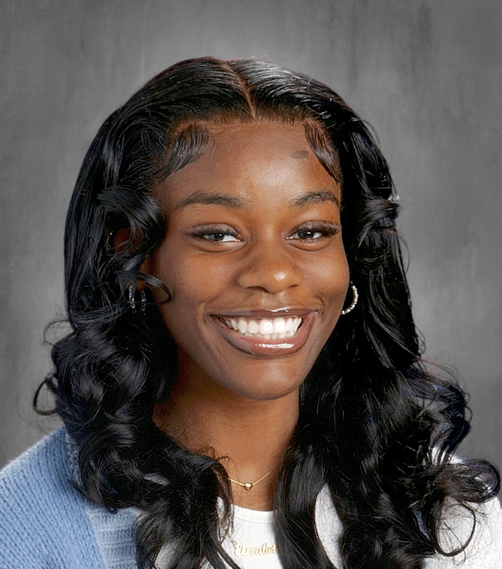
2025 AKOMA Nona Patterson Chambers Scholar
Hazel Roberts
MOTHER: Danette L. Wortham-Coston
MAJOR: Business Administration
MINOR: Psychology
HIGH SCHOOL: Joseph C. Wilson Magnet High School
UNIVERSITY: Hampton University (VA)
GOAL: CEO of multiple Fortune 500
Companies &
United States Supreme Court Justice

Slide 14
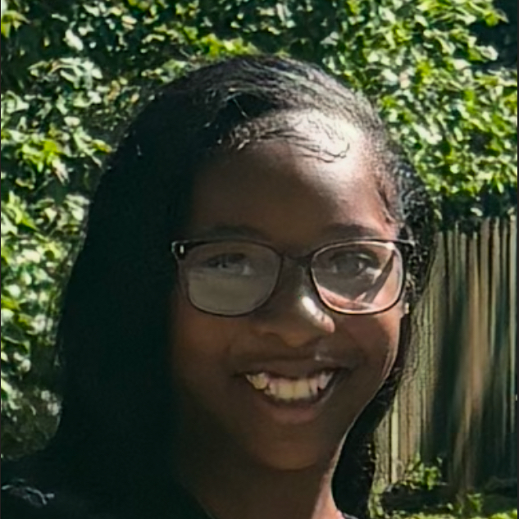
2025 AKOMA Nona Patterson Chambers Scholar
Destiny Stroughter
PARENTS: Michael and Nicole Stroughter
MAJOR: Psychology
MINOR: Theater and Dance
HIGH SCHOOL: Rochester Early College
International High School
UNIVERSITY: Plattsburgh University (NY)
GOAL: Psychotherapist

Slide 15

You may shoot me with your words,
You may cut me with your eyes,
You may kill me with your hatefulness,
But still, like air, I’ll rise.
~ Maya Angelou

